Slide 1
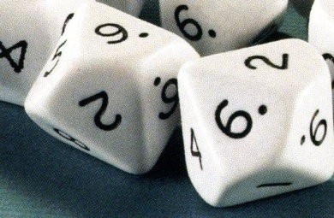
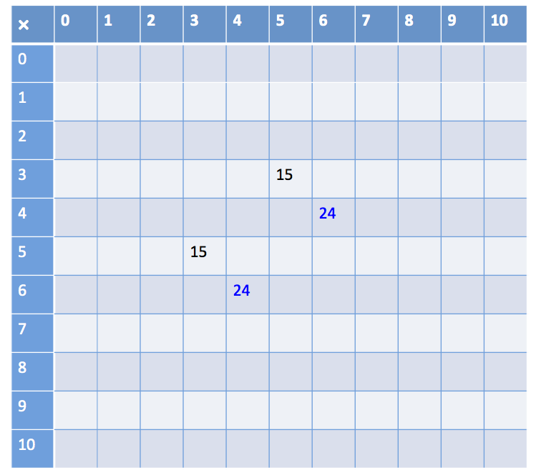
Instructions
What do I know?
Materials: Blank multiplication grid and two 10-sided (0-9) dice per pair, coloured pencils.
In pairs, students take turns to roll the dice and generate a multiplication fact. For example,player A rolls (5, 3) and player B says “5 threes are 15,
and 3 fives are 15”.
Player B records
15 in the appropriate
cells on the grid
using a coloured
pencil.

Slide 2
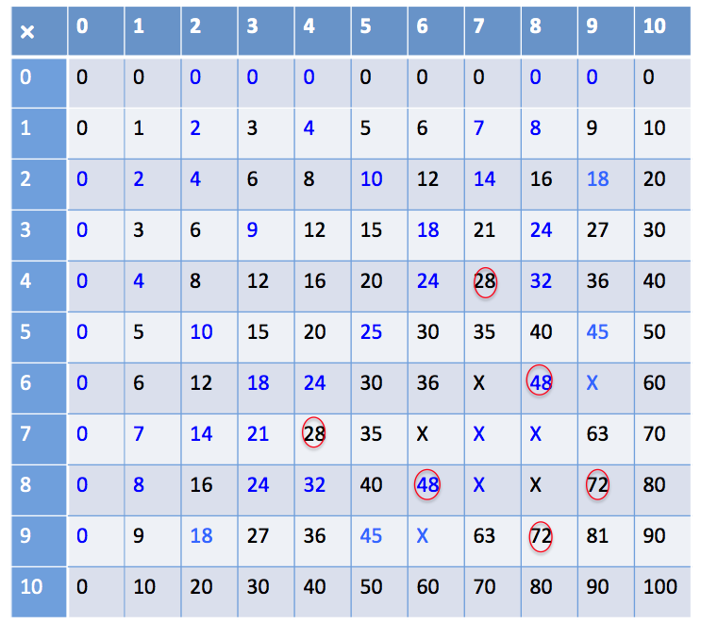
Instructions
What do I know?
If a player takes a long time to work out the product, it is recorded in the cell with a circle around it. If a player does not know then a cross is put in the cell.

Slide 3
Instructions
What do I know?
Play continues until all the cells are filled. They can record the facts for 10 as they cannot be generated using the dice.
Students discuss and list some of the strategies used for the facts that were tricky to work out. For example, using 4 × 4 and doubles to work out 8 × 4.

Slide 4
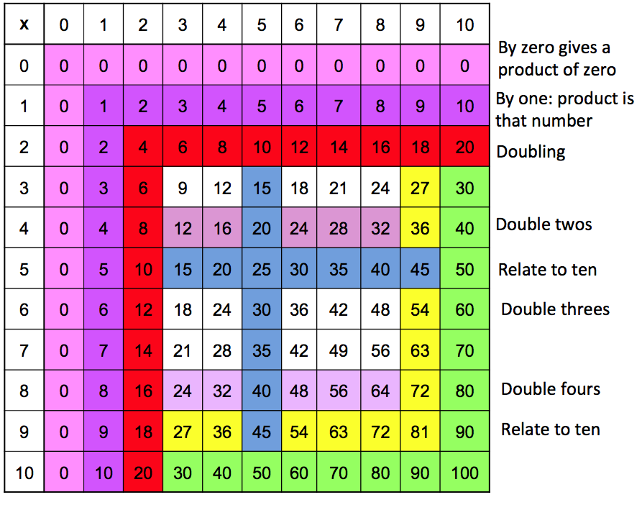
Instructions
What do I know?

