Slide 1
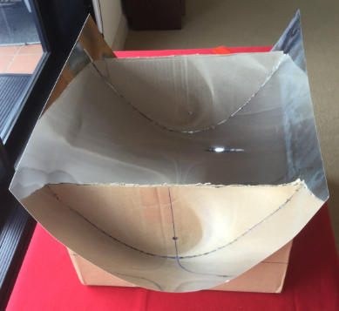
The parabolic solar trough sausage sizzle

Slide 2
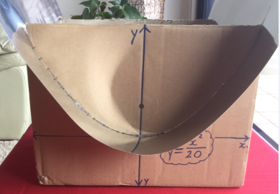
Do-it-yourself parabolic solar sausage sizzle.
Follow the step-by-step instructions.

Slide 3
Step 1: Collect a sturdy open top box. Choose a face to be the cross-section of your parabolic trough.

Slide 4
Step 2: Use a ruler and pencil to draw the y-axis down the centre of the face. Measure carefully to ensure your y-axis is an axis of symmetry. Repeat for the opposite face.

Slide 5
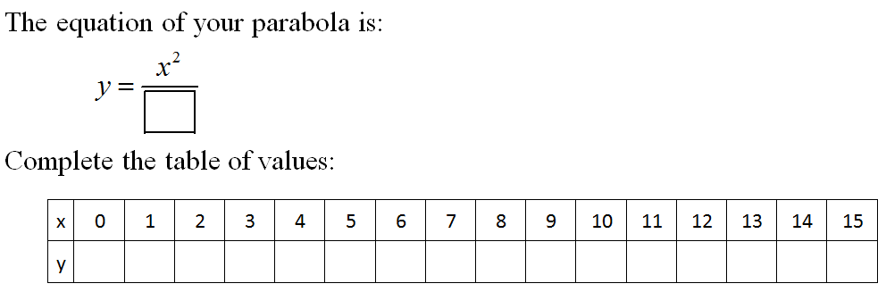
Step 3: Use the sheet of paper and a calculator to complete your table of values for the equation you have been given.

Slide 6

Step 4:
Lay your sheet of baking paper on the desk in the landscape orientation.
Fold it in half down the centre from top to bottom.
Open it up and draw a y-axis on the crease.

Slide 7
y-axis
first quadrant
x-axis
second quadrant
Step 5: Using this point as the origin, use a ruler to:
Mark a scale on the x-axis using 1 cm for every unit.
Mark a scale on the y-axis using 1 cm for every unit.

Slide 8
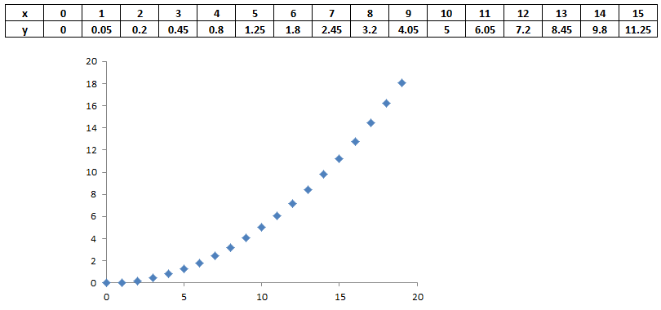
Step 6a:
Carefully plot the points in the first quadrant onto your baking paper Cartesian plane.

Slide 9
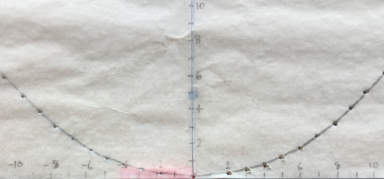
Step 6b:
Fold the baking paper in half along the y-axis and trace the points into the second quadrant, so that your parabola will be symmetrical about the y-axis.

Slide 10
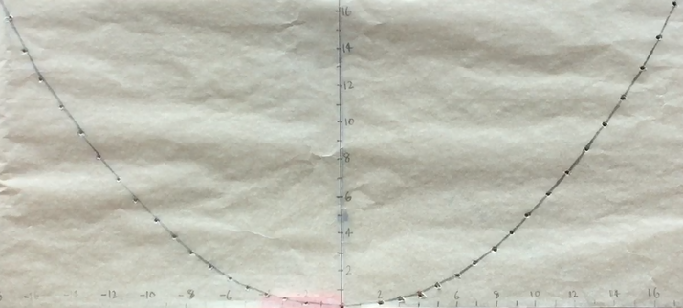
Step 7:
Use a pencil to join the points with a smooth curve

Slide 11
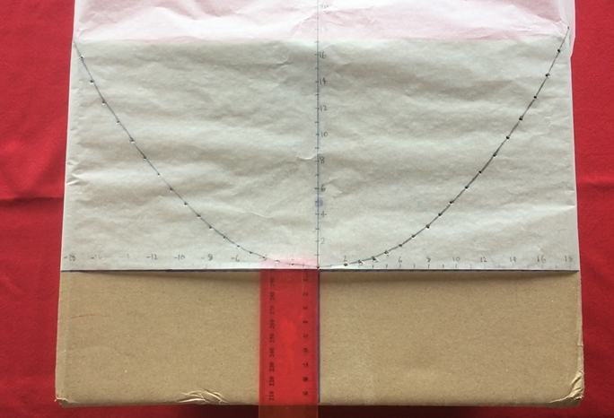
Step 8:
Turn your box so that the cross-section is facing up.
Place your baking paper on the face of the box so that:
The y-axis on the baking paper lines up with the y-axis on the box, and
The curve on the baking paper passes through the top corners of the box.
Use sticky tape to attach you baking paper to the box.

Slide 12
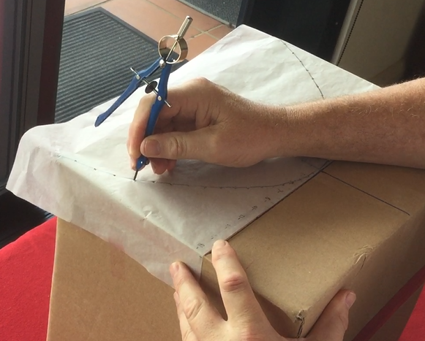
Step 9: Use a sharp object (a pencil will do) to punch a series of holes through the box.
Carefully remove the baking paper. Don’t rip it.
You will need it for the opposite face of the box.

Slide 13
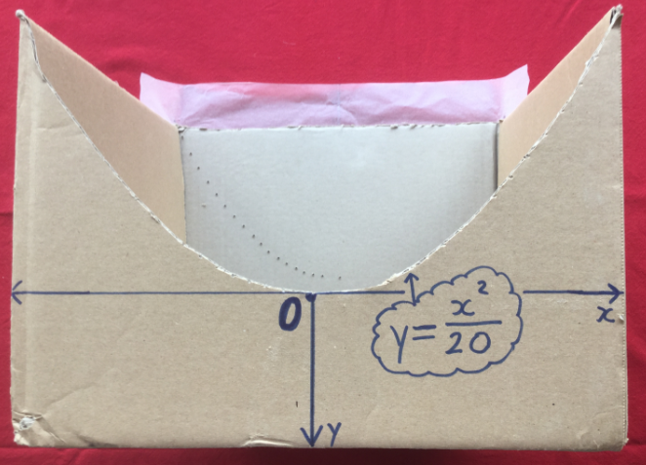
Step 10: Use a box cutter (very carefully), or many holes stabbed with the pencil, to remove the parabolic section from the box.

Slide 14
Step 11: Stick the baking paper to the other end of the box then repeat Steps 9 and 10.

Slide 15
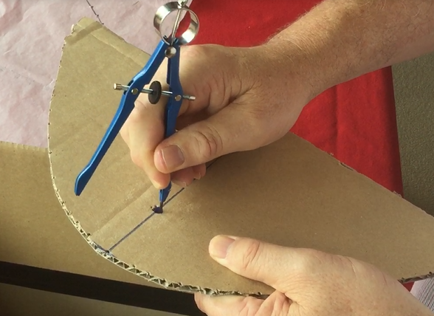
Step 12: Look at the number in the denominator of your equation. Divide it by 4. That will be your focal length. Measure this distance from the vertex along the y-axis. Make a hole at that point.
Repeat Step 11 for the other end of the box.
Why divide by 4?
Fill in the proof:
Why_divide_by_4_teacher_version.pdf
Focal length

Slide 16
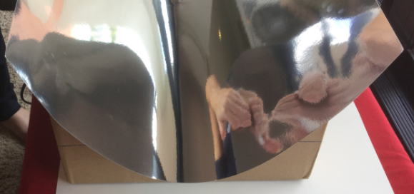
Step 13:
Place a sheet of silver cardboard into the box so it forms a parabolic trough.
Use glue or tape to hold it in place.

Slide 17
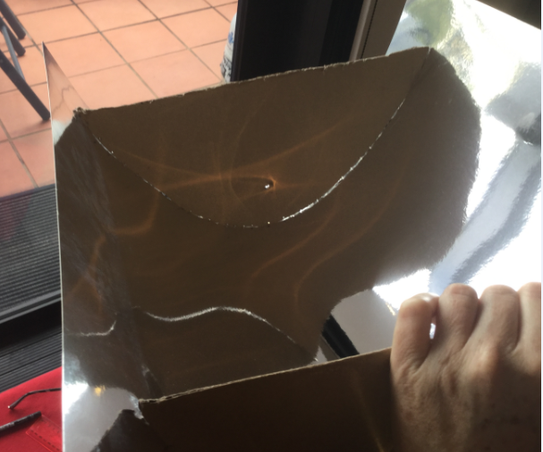
Step 14: Put the parabolic sections back into the places from where they came.
It may be necessary to trim them so they fit neatly.
Use glue or tape to hold them firmly in place.

Slide 18
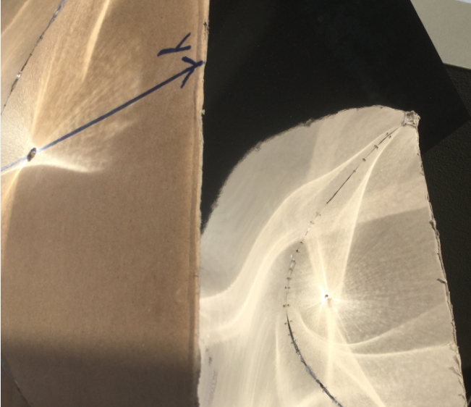
If you point your box in the correct direction, you should be able to see the suns rays being reflected to the focus.
Focus

Slide 19
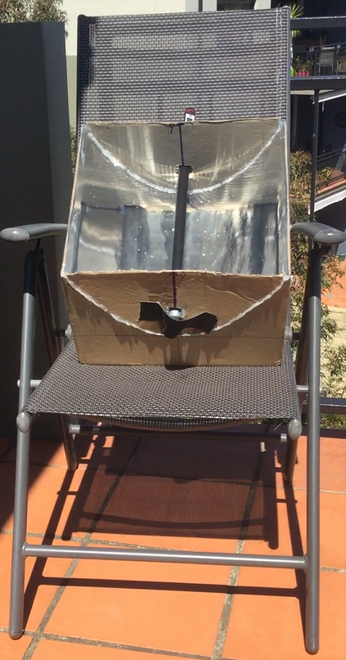
Boiling water
A simple set-up:
Rotate the chair so that the shadow of the front leg lines up with the back leg.

Slide 20
A section of black PVC pipe.
It is capped at one end and full of water.
It has been placed so that the sun is reflected onto the pipe.

Slide 21
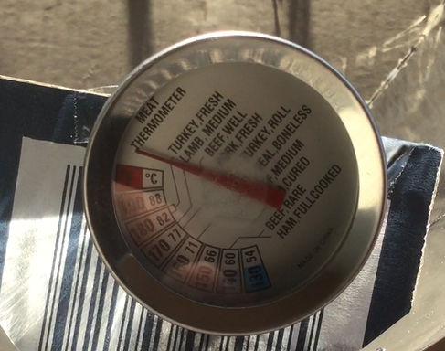
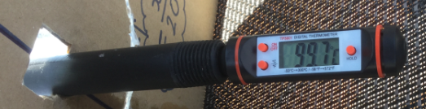
The water went from room temperature
to boiling in about 20 to 25 minutes.

Slide 22
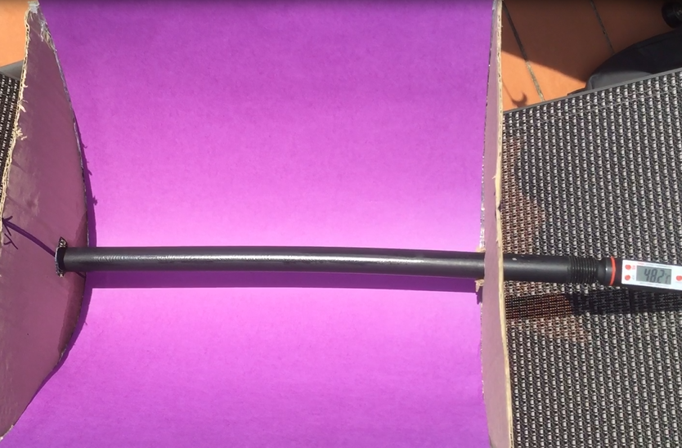
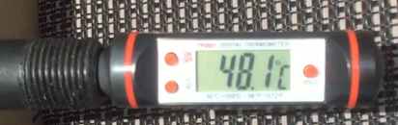
When the silver sheet was replaced with a purple sheet the water temperature dropped to 48.1 degrees.
Conclusion:
Under identical conditions, the parabolic silver sheet increased the water temperature by approximately 50 degrees.

Slide 23
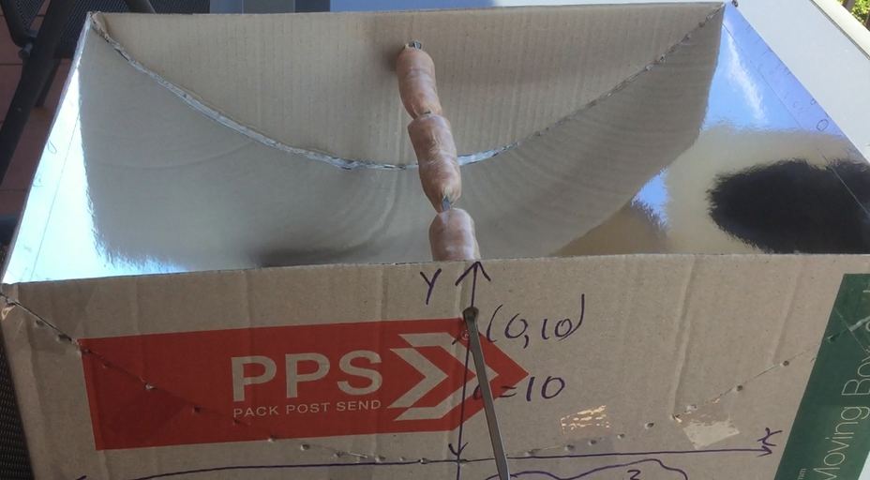
Cooking trial:
Pork chipolatas

Slide 24
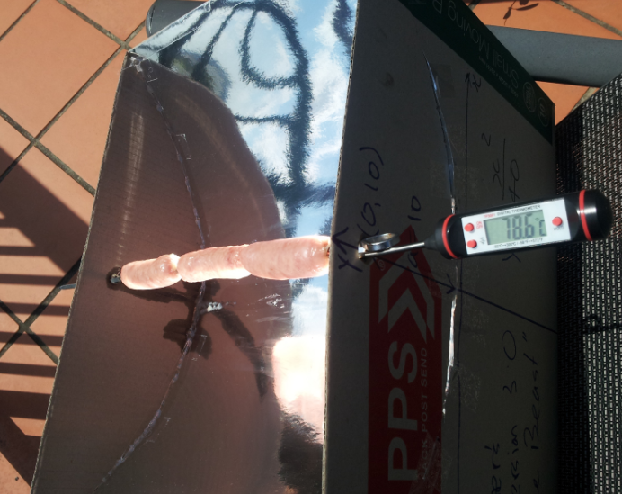
This experiment was conducted in Sydney in September on a sunny day. The air temperature was 20 degrees.
The sausages went from ‘refrigerated’ to 78.6 degrees in about 20 minutes. They were cooked in 75 minutes.
Fat dripping from the cooking sausages.

Slide 25
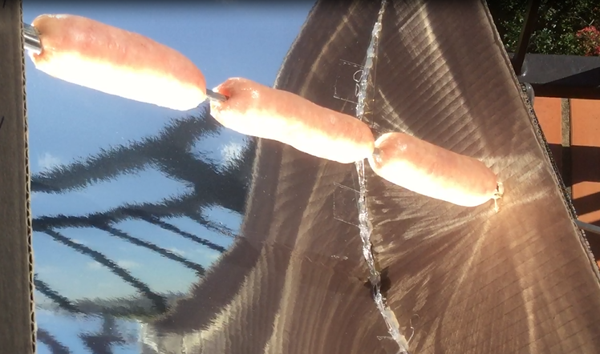
Cooking trial:
Pork chipolatas

Slide 26
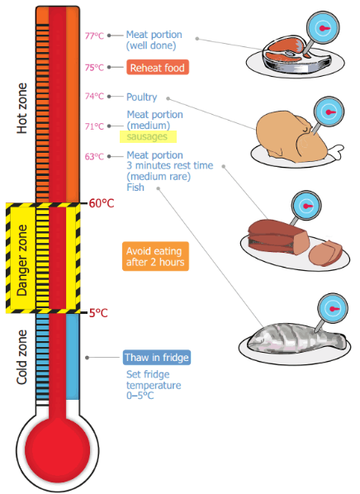
Is it safe?
Different meats require different cooking temperatures to destroy harmful bacteria.
It’s a good idea to invest in a food thermometer and use it.
http://www.foodauthority.nsw.gov.au/foodsafetyandyou/food-at-home/cooking-temperatures

Slide 27
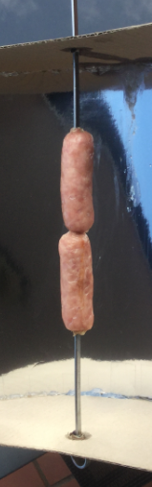
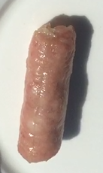
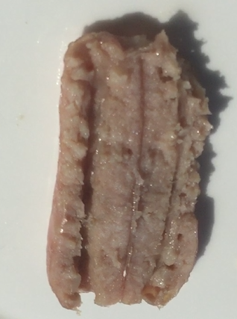
Bon appetit!

